Slide 1



Slide 2
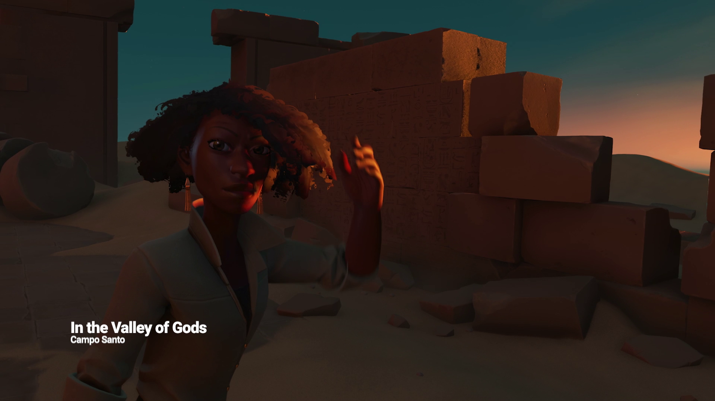

Slide 3
Unity tools to accelerate your MR Development

Slide 4
Arturo Nereu @ArturoNereu - arturo@unity3d.com

Slide 5
Headline can go in two lines if necessary and will center-align vertically.
First level. Class aptenttacitisociosqu ad litoratorquent per conubia nostra, per inceptoshymenaeos.
Second level. Nam quam nunc, blanditvel, luctuspulvinar, hendrerit id, lorem.
Morbi ac felis. Phasellusnecsem in justopellentesquefacilisis.
Nullamnullaeros, ultricies sit amet.
Collaboratively brand fully tested expertise and distinctive meta-services.
Professionally alternative ROI rather than vertical best practices.
Proactively evisculate clicks-and-mortar human capital through state of the art users.

Slide 6
ProBuilder

Slide 7
TextMesh Pro

Slide 8
Timeline

Slide 9
Thank you! @ArturoNereu - arturo@unity3d.com

